Slide 1
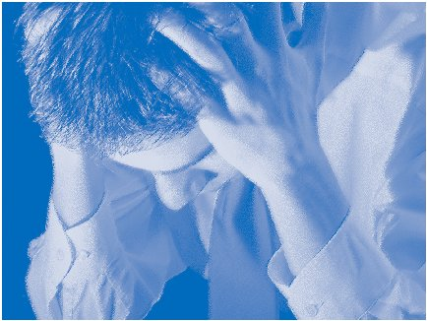
STRESS MANAGEMENT

Slide 2
PRESENTED BY:
DEEPIKA TYAGI
LECTURER IN TEACHING OF ECONOMICS
R.M.S.COLLEGE OF EDUCATION

Slide 3
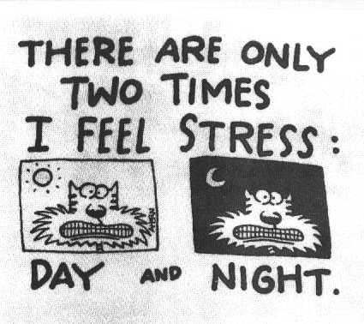

Slide 4
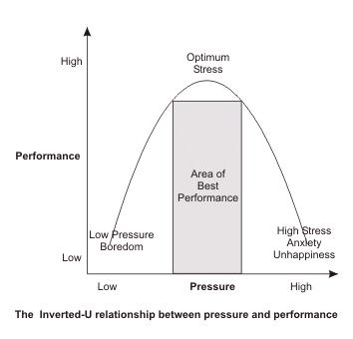

Slide 5
STAGES OF STRESS
Stress Arousal Stage
Persistent irritability and anxiety
Bruxism and/or Insomnia
Occasional forgetfulness and/or inability to concentrate
Stress Resistance Stage
Absenteeism or tardiness for work
Tired and fatigued for no reason
Indecision
Social withdrawal
Resentful, indifferent, defiant Increased use of coffee, alcohol, tobacco, etc.

Slide 6
Severe Exhaustion Stage
Chronic mental and physical fatigue
Chronic stress related illnesses (headache, stomach ache, bowel problems, etc.)
Isolation, withdrawal, self-destructive thoughts
Chronic sadness or depression

Slide 7
MAJOR MYTH OF STRESS
Stress is inevitable--there's little we can do to prevent or eliminate it.
Stress is something we can cope with or deal with directly.
Some degree of stress is good or healthy for us.
The best way to deal with stress is to manage it.
Our mind plays a role in much of the stress we experience.

Slide 8
CAUSES OF STRESS
Stress at work
Too much work
Time pressures and deadlines
Apparent lack of support
Unclear expectations
Responsibilities
Disruptions
The demands of the job
Their relationships with colleagues
How far the company consults staff over workplace changes.

Slide 9
MAJOR STRESSORS FOR TEACHERS
Norms and standard set by NCTE.
Rules and regulations set by the concerned University.
Various conditions set by State Level Agency.
Expectations of NCERT from the institutions to go hand in hand with the changing times.
Competitive attitude of the institution for the attainment of higher grade from NAAC.
Management’s expectations for optimum utilization of minimum resources.

Slide 10
own pressure to develop professionally.
Frequent changes in the time table.
Unending co-curricular activities .
Lesser number of full time faculties available.
Extra cordial relation with staff and heads of the practicing school.
Society entrusts responsibility.

Slide 11
Life causes
Death: of spouse, family, friend
Health: injury, illness, pregnancy
Crime: Sexual molestation, mugging, burglary, pick-pocketed
Self-abuse: drug abuse, alcoholism, self-harm
Family change: separation, divorce, new baby, marriage
Sexual problems: getting partner, with partner
Argument: with spouse, family, friends, co-workers, boss
Physical changes: lack of sleep, new work hours
New location: vacation, moving house
Money: lack of it, owing it, investing it
Environment change: in school, job, house, town, jail
Responsibility increase: new dependent, new job

Slide 12
EFFECTS OF STRESS
Cardiovascular System
Impaired heart function; can cause angina
Constriction of the peripheral blood vessels, thereby raising blood pressure
Digestive System
Stomach upsets, even ulcers
Diarrhea
Gastritis
Peptic ulcers
Irritable Bowel Syndrome
Canker sores in the mouth

Slide 13
Respiratory System
Asthma
Musculoskeletal System
Tension in skeletal muscles and joints, leading to backache and muscular aches and pains
Immune System
Weakened defenses, with lowered resistance to infections
Viral illnesses (often due to a depleted immune defense system)
Allergies
Malignant cell changes; cancer

Slide 14
Endocrine System
Menstrual disorders
Thyroid disorders (underactive, overactive, thyroiditis)
Central Nervous System
Anxiety, depression, and fatigue
Reproductive System
Infertility
Premature ejaculation
Impotence

Slide 15
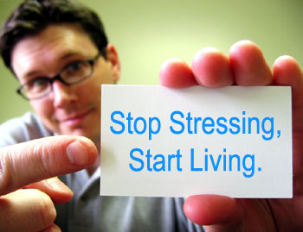
STRESS MANAGEMENT STRATEGIES
Avoid unnecessary stress
Learn how to say “no”
Avoid people who stress you out
Take control of your environment
Avoid hot-button topics
Pare down your to-do list

Slide 16
ALTER THE SITUATION
Express your feelings instead of bottling them up.
Be willing to compromise.
Be more assertive.
Manage your time better.

Slide 17
Adapt to the stressor
Reframe problems.
Look at the big picture.
Don’t try to control the uncontrollable.
Look for the upside.
Learn to forgive.

Slide 18
ADOPT A HEALTHY LIFE STYLE
Exercise regularly.
Eat a healthy diet.
Reduce caffeine and sugar.
Avoid alcohol, cigarettes, and drugs.

Slide 19
GET SOUND SLEEP

Slide 20
Positive thinking
Focus on your strengths
Learn from the stress you are under
Look for opportunities in the stressful situation
Seek out the positive – make a change

Slide 21
MUSIC THERAPY
Sound bath with relaxing music.
Take walks with your favorite music.
Listening to the sounds of nature.

Slide 22
HUMOR THERAPY

Slide 23
NATURE WALKS

Slide 24
YOGA AND MEDITATION

Slide 25
SPIRITUALISM

Slide 26
COUNSELING

Slide 27
THANKS & ALL THE BEST

